Slide 1
Man is born free, but is everywhere seen bound by chains -Voltaire

Slide 2
American Revolution vs. French Revolution
American Revolution
French REvolution
British taxing colonies without representation
People have the right to “life, liberty, and the pursuit of happiness” –Thomas Jefferson
Form a Federal Republic:
President, Congress, Supreme Court
Citizens felt oppressed by King Louis XVI
Oath of the Tennis Court (French declaration of rights)
Bloody revolution
The result of both revolutions was a drastic shift in styles of government
Monarchy→Constitutional Monarchy→Federal Republic

Slide 3
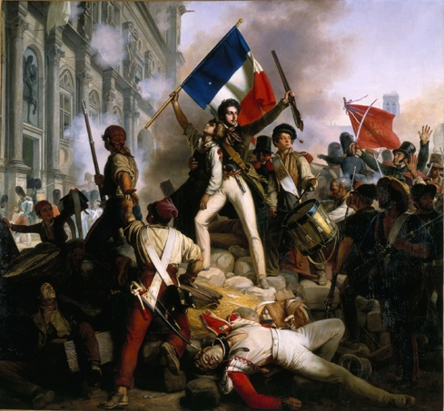
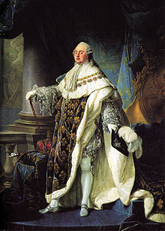

Slide 4
